Slide 1
Introduction to Data Science Data Mining for Business Analytics
Brian d’Alessandro
VP – Data Science, Dstillery
Adjunct Professor, NYU
Fall 2014
Fine Print: these slides are, and always will be a work in progress. The material presented herein is original, inspired, or borrowed from others’ work. Where possible, attribution and acknowledgement will be made to content’s original source. Do not distribute, except for as needed as a pedagogical tool in the subject of Data Science.
Notes:
https://www.youtube.com/watch?v=aMDe5pODkB0 (harlan harris)

Slide 2
Course fundamentals

Slide 3

Instructor
Bio
Education:
Undergrad: Rutgers, Math
Grad: NYU Stern, Statistics
Professional Experience
Dstillery (AdTech)
Meetup.com (Social Web)
American Express (Credit/Risk)
TV Guide (Marketing)
Affiliations/Publications
ACM KDD
Big Data Journal
Machine Learning Journal
SIAM
Brian d’Alessandro
Notes:
Add brief bio

Slide 4
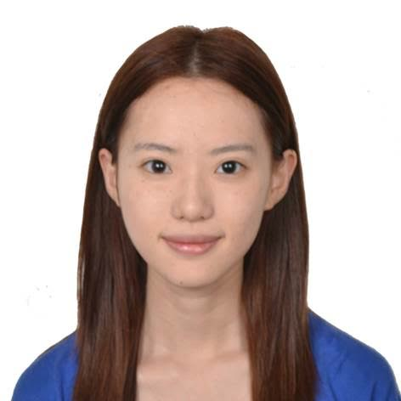
Ta yuan feng
Office hours:
Thursday 3:00-5:00 PM at the CDS space
(726 Broadway, 7th Floor), or by appointment.
Bio:
Yuan is a graduate student in Master of Science in Data Science Program. She is passionate about data science and she loves to help people.
Notes:
Add brief bio

Slide 5
Goals of this course
Understand what a Data Scientist is
Approach applicable problems data-analytically
Have hands-on experience mining data
Notes:
Add brief bio

Slide 6


Programming!
In order to succeed and participate in this class,
You will…
Need access to a computer with admin privileges
Have to learn and use the Python programming language.
Please see me after class if this is an issue.
Notes:
Add brief bio

Slide 7
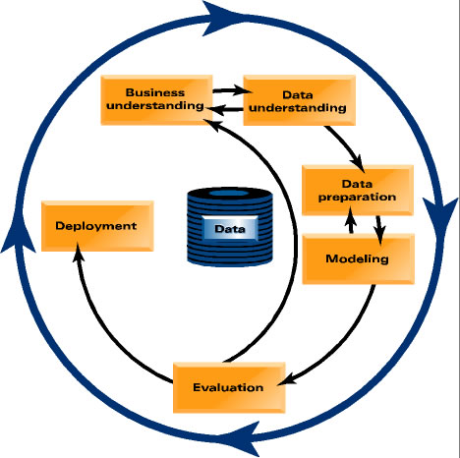
Lecture outline
This course will work in the same flow as a typical data mining project.
We’ll also peel the layers of data mining like an onion, so the flow might not always be linear.
Notes:
Do something more illustrative than a table.

Slide 8
homework
Will be announced the week they’re assigned
We’ll spend time in class discussing what is expected
Are all expected to be performed solo
Discussions are welcome and encouraged on the course forum
Will involve Python analysis with discussion of results
Open questions will be assigned
Code and open answers to be turned in
Notes:
Show photos of stats and pandas

Slide 9
Final project
The final project will pull together all of the elements you learn from this class and will simulate the experience of being an professional data scientist. Ultimately, we want you to be able to identify a problem, implement a solution, and demonstrate the value of your solution.
Milestones (due dates will be assigned)
Choose a team
Pick a dataset and a business problem, write a proposal
Explore and validate the utility of the data
Write a professional report
Present to the class
Notes:
Show photos of stats and pandas

